Slide 1
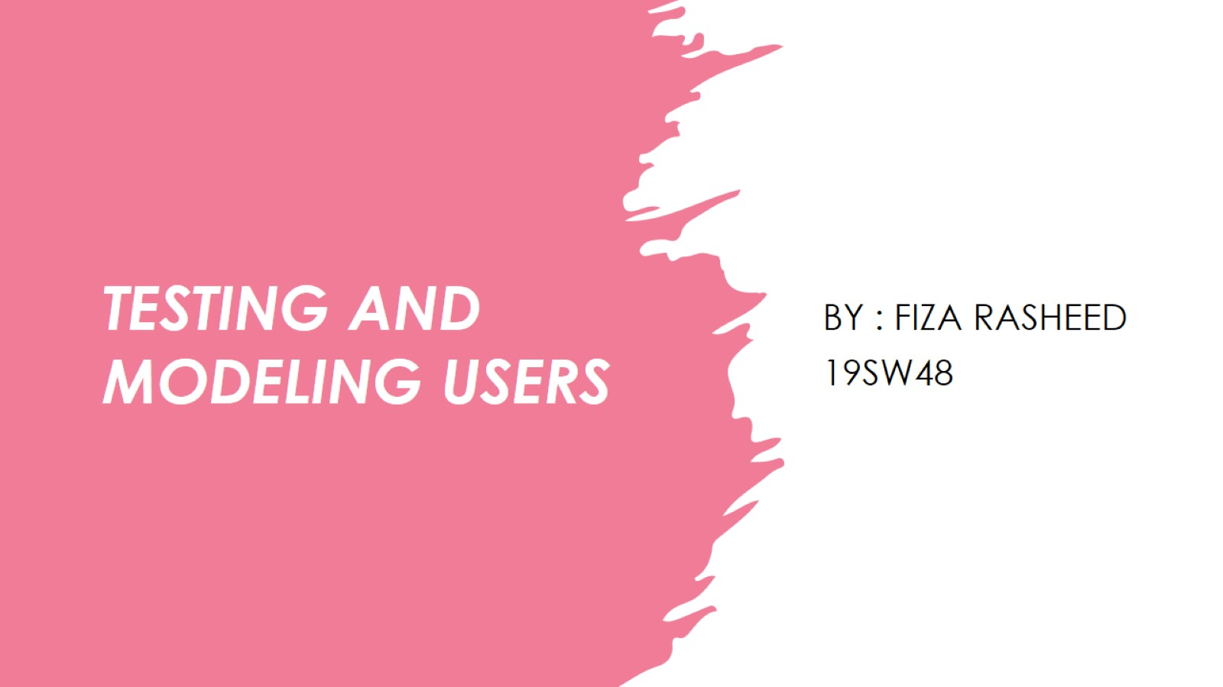
TESTING AND MODELING USERS

Slide 2
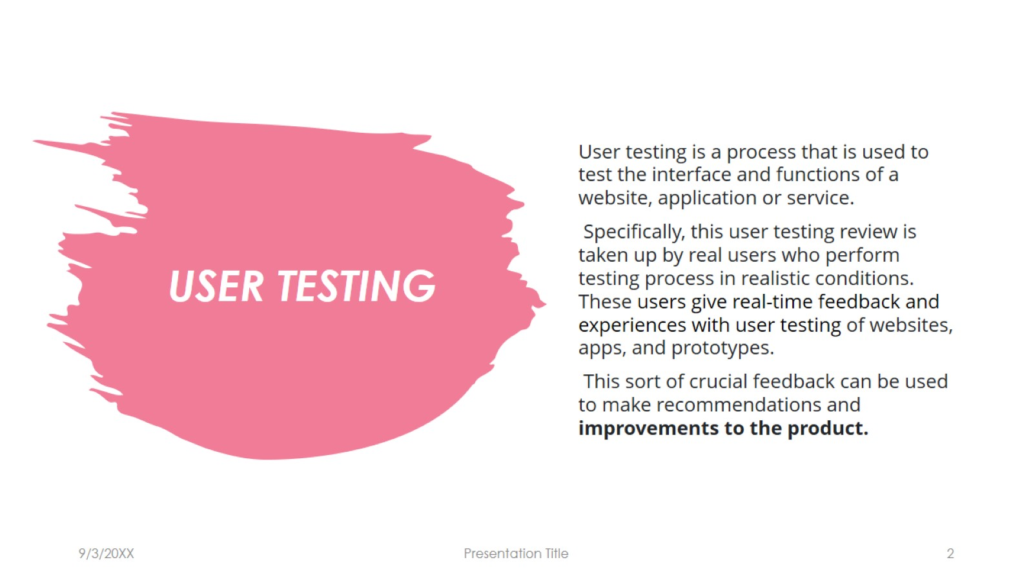
USER TESTING

Slide 3
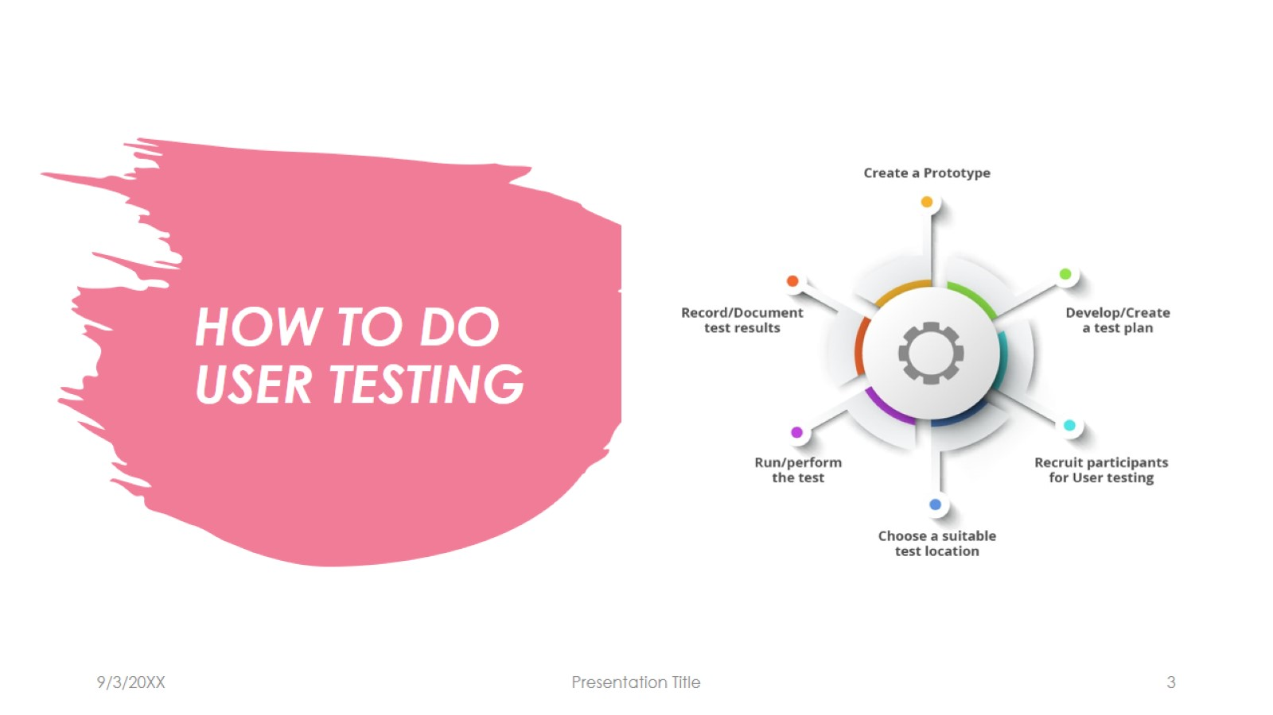
HOW TO DO USER TESTING

Slide 4
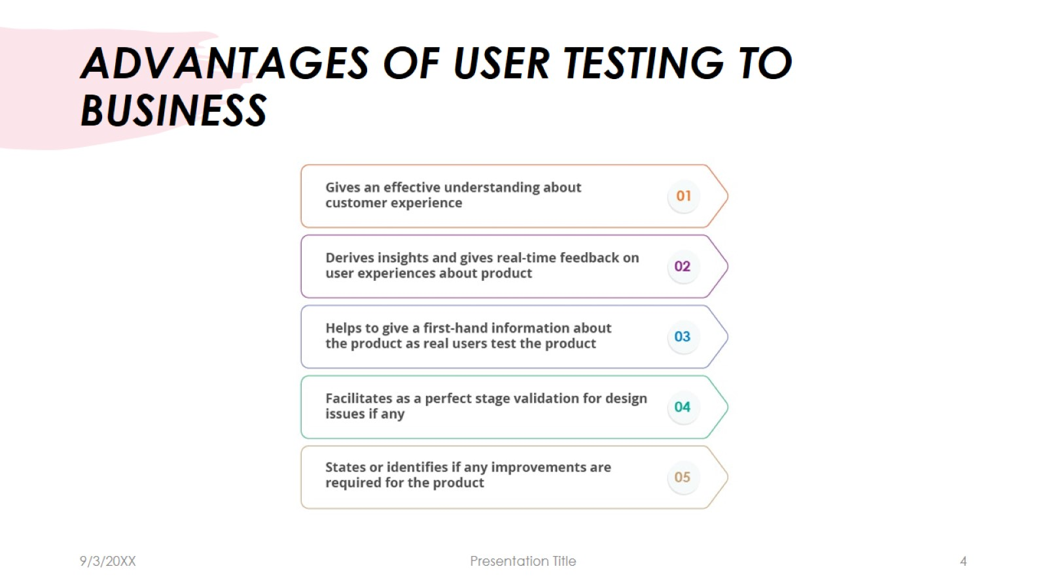
ADVANTAGES OF USER TESTING TO BUSINESS

Slide 5
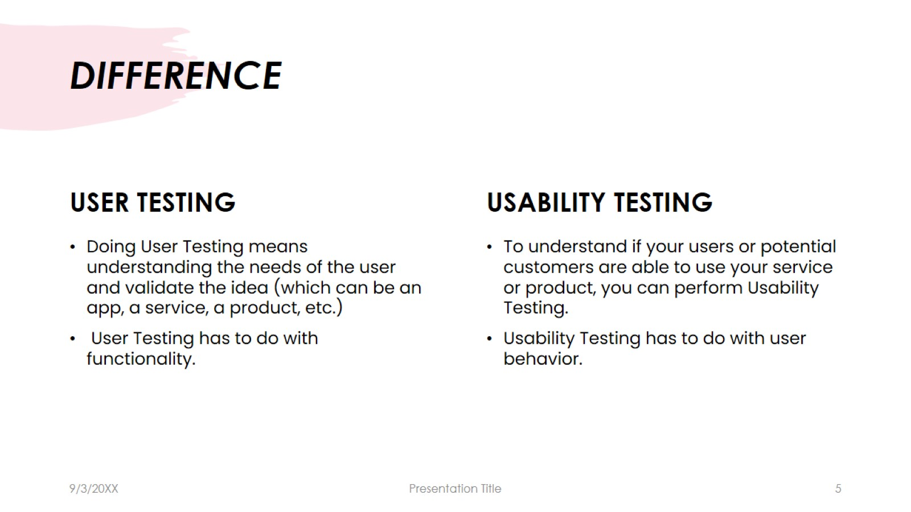
DIFFERENCE

Slide 6
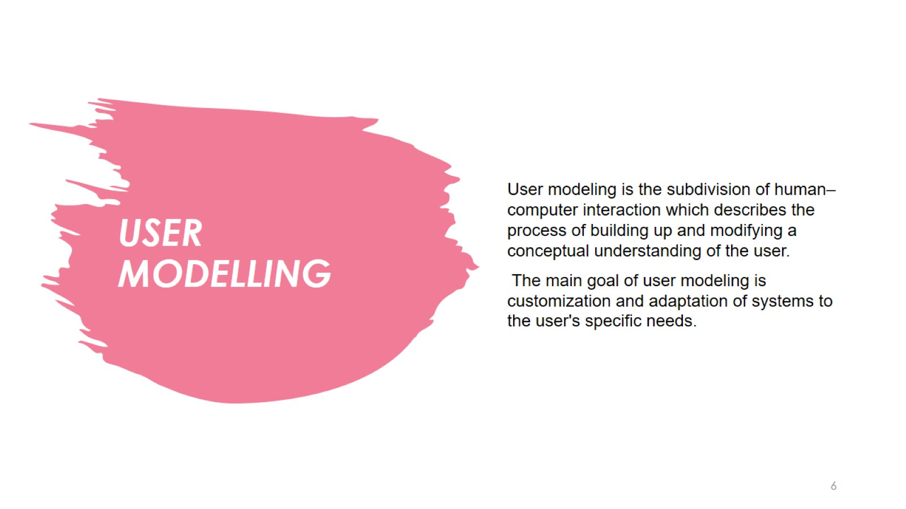
USER MODELLING

Slide 7
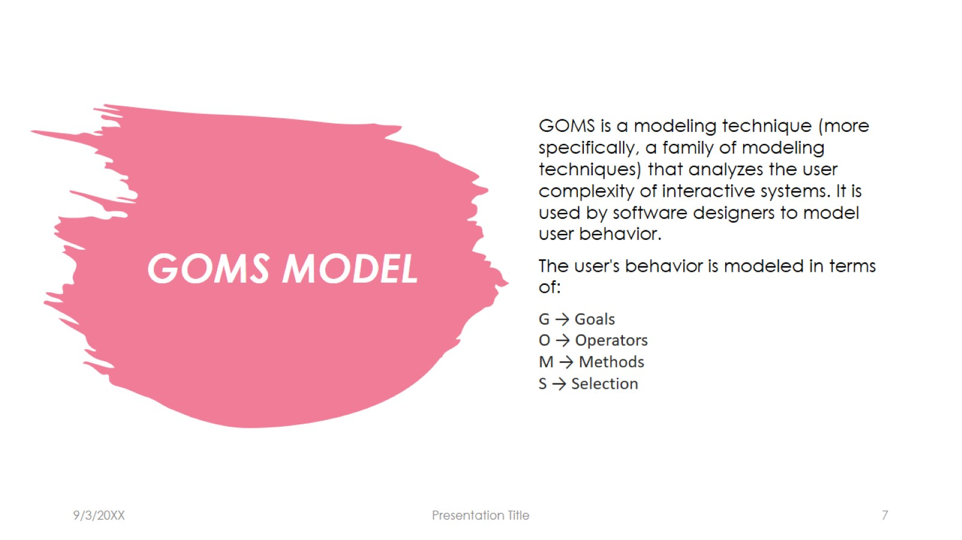
GOMS MODEL

Slide 8
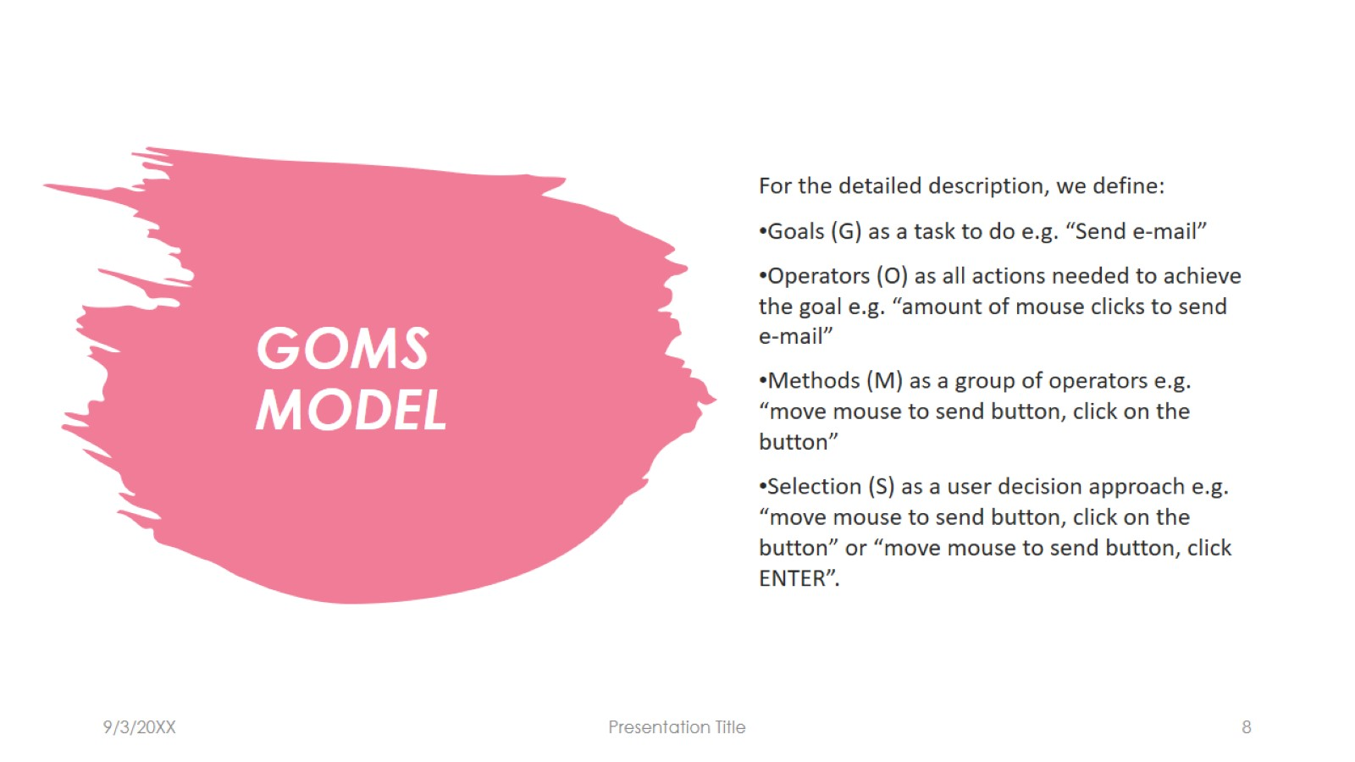
GOMS MODEL

Slide 9
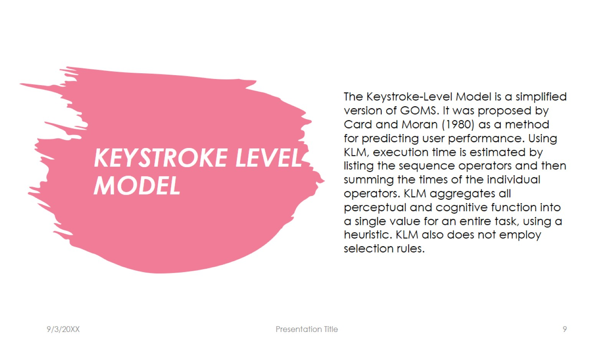
KEYSTROKE LEVEL MODEL

Slide 10
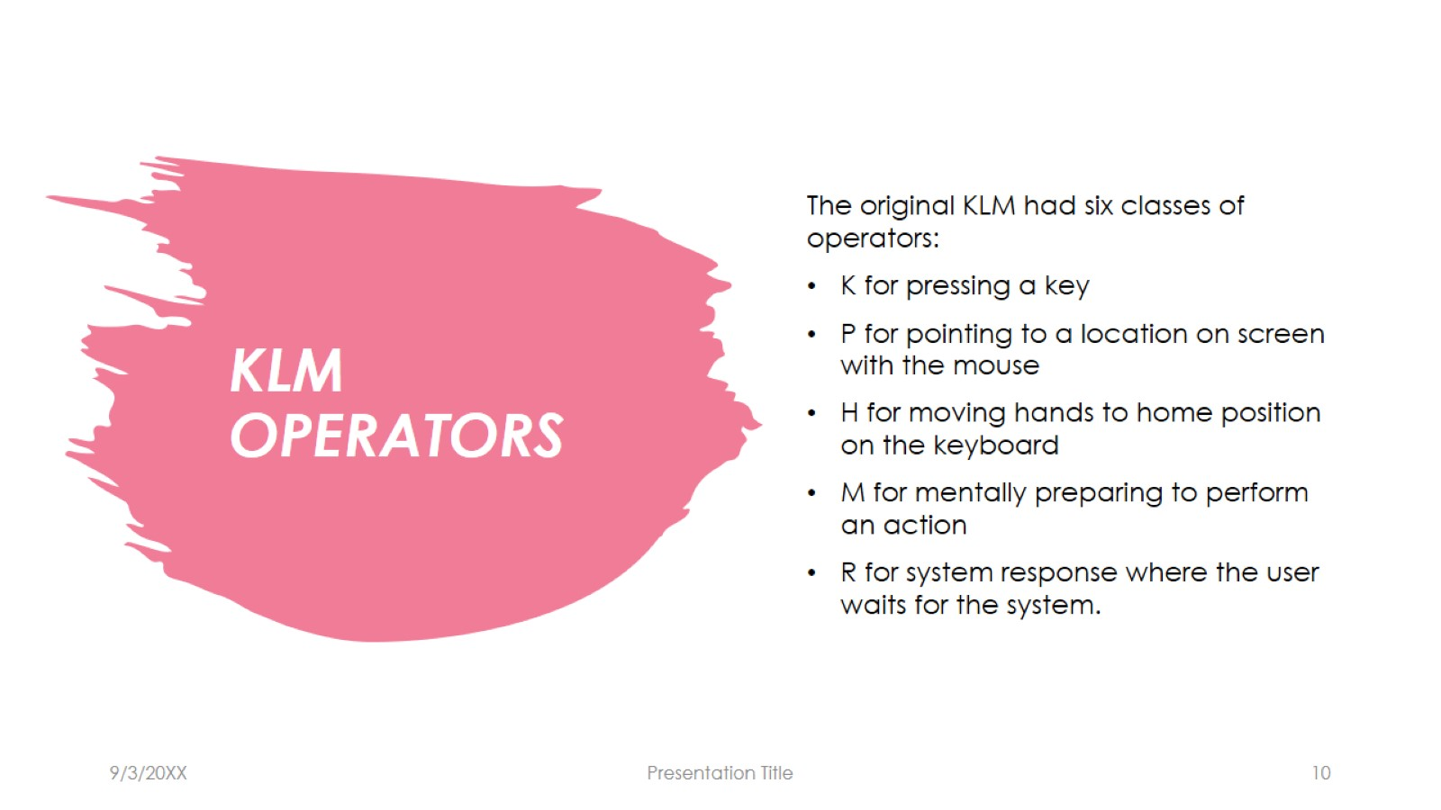
KLM OPERATORS

Slide 11
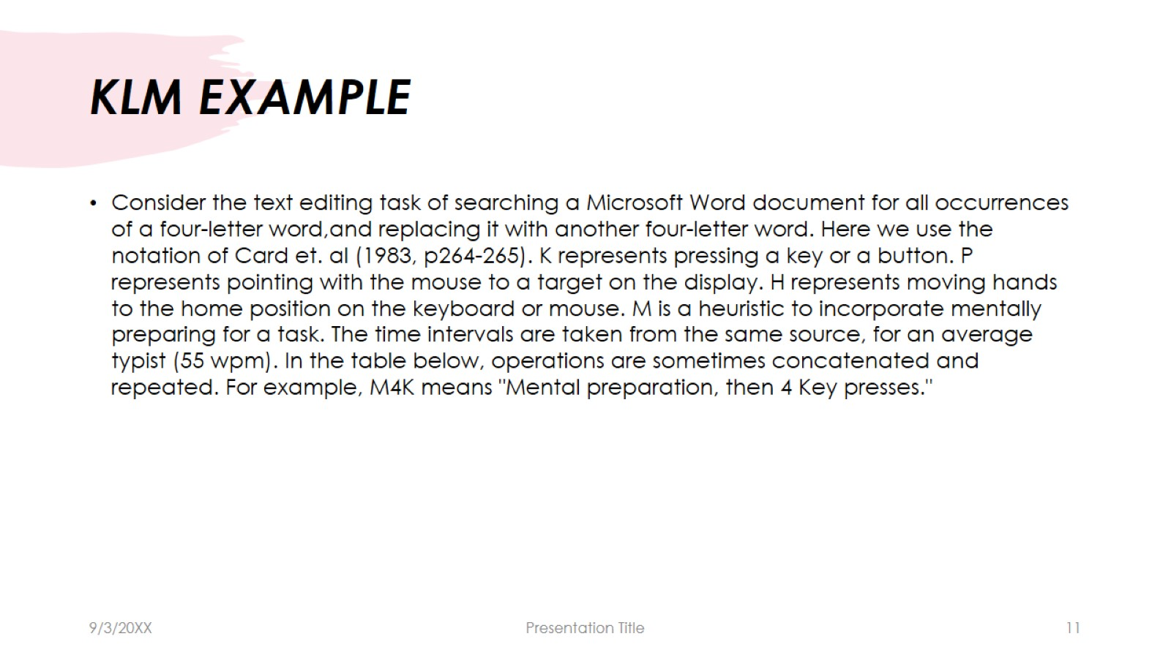
KLM EXAMPLE

Slide 12
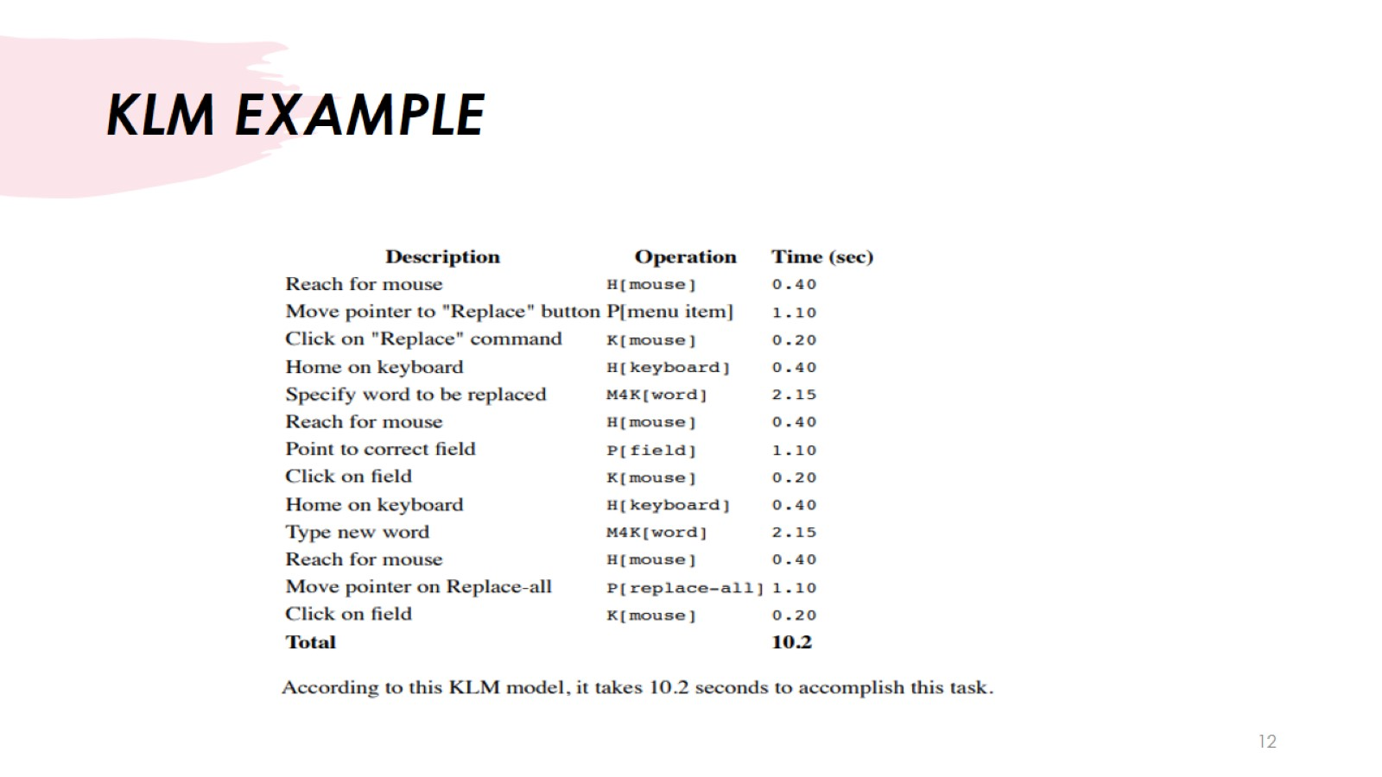
KLM EXAMPLE

Slide 13
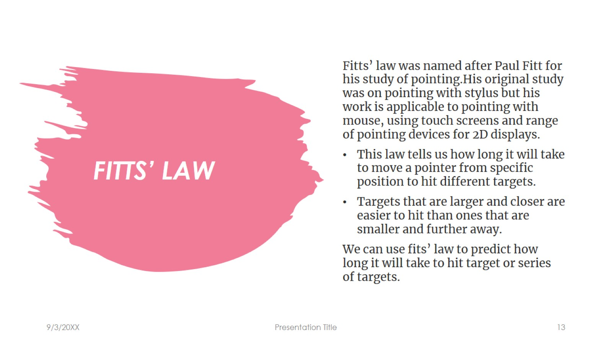
FITTS’ LAW

Slide 14
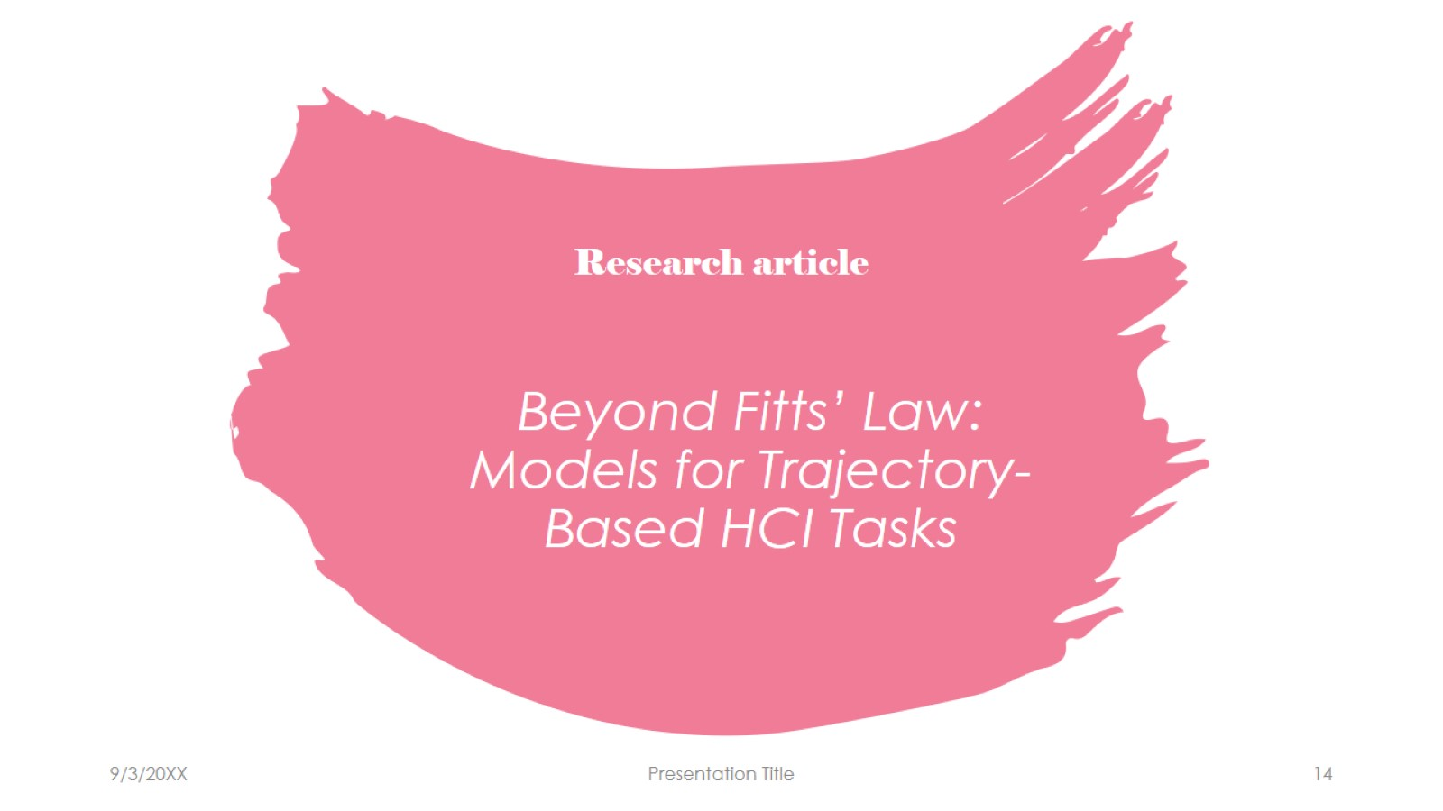
Beyond Fitts’ Law: Models for Trajectory-Based HCI Tasks

Slide 15
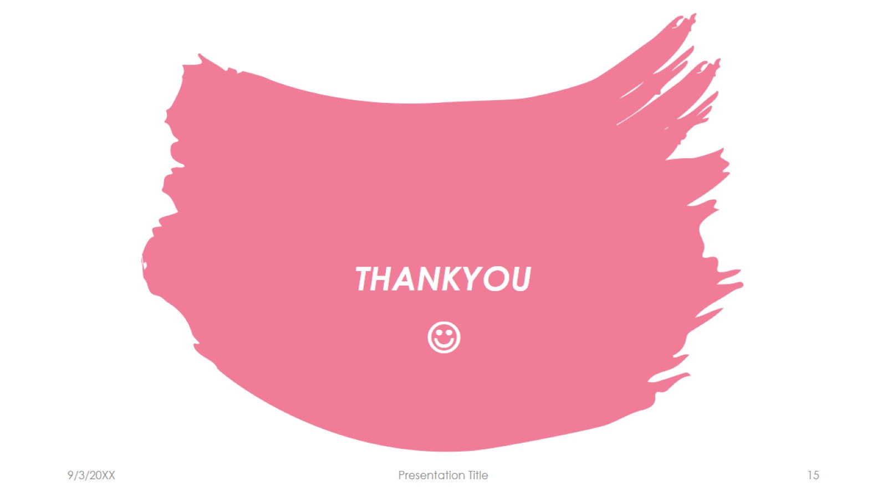
THANKYOU

